Slide 1

LIBRARY MANAGEMENT
K VENKAT NAVEEN KUMAR
1009-17-861-095
BCA III Year
Guide : G .SAHAJA
NIZAM COLLEGE

Slide 2
Contents
S NO. | Description
1) | Abstract
2) | Introduction
3) | Existing System
4) | Proposed System
5) | Module Description
6) | Hardware and Software Requirements
7) | Technologies Used
8) | Analysis
9) | System Architecture
10) | Design
11) | Conclusion
12) | Future Work
13) | References

Slide 3
Abstract
Library Management developed in Java Swing technology which mainly for monitoring and controlling the transactions in a library . Library Management mainly focuses on basic operations in a library like adding new member, new books, and updating new information, searching books and members and facility to borrow and return books.

Slide 4
Introduction
“Library Management” is java-based desktop application written for Windows operating systems, designed to help users maintain and organize library. Our software is easy to use for both beginners and advanced users.
PURPOSE
The software Library Management has four main modules.
Insertion to Database Module – User friendly input screen
Extracting from Database module – Attractive Output Screen
Report Generation module – borrowed book list & Available book list
Search Facility system – search for books and members
PROBLEM STATEMENT
Library Management system is to allow for storing details of a large number of books, magazines, Journals, thesis and allow for add, search, borrow, return facilities separately to administrator/Librarian, staff and students.

Slide 5
Existing System
In our existing system all the transaction of books is done manually, so taking more time for a transaction like borrowing a book or returning a book and also for searching of members and books.
Another major disadvantage is that to preparing the list of books borrowed and the available books in the library will take more time, currently it is doing as a one-day process for verifying all records.
So, after conducting the feasibility study we decided to make the manual Library management system to be computerized.

Slide 6
Proposed System
Proposed system is an automated Library Management.
Through our software user can add, remove, list and update books and members. And also, search books and members in quick time.
User can borrow and return books.
It provides automated late fee calculation. It has option for help.
Our proposed system has the following advantages.
User friendly interface
Fast access to database
Less error
More Storage Capacity
Search facility
Look and Feel Environment
Quick transaction
All the manual difficulties in managing the Library have been rectified by implementing computerization.

Slide 7
Module Description
Users Of System:
Admin
Librarian
Modules of the System:
Admin Module
Librarian Module
Authentication
Reports

Slide 8
1) ADMIN
FILE:
Change Password
Logout
EDIT:
Add Librarian
Remove Librarian
List Librarians

Slide 9
2) LIBRARIAN
FILE:
Change Password
Logout
BOOK:
Add Book
Remove Book
Edit Book
MEMBER:
Add Member
Remove Member
Edit Member

Slide 10
Loan:
Borrow Book
Return Book
Reports:
List All Books
List All Members
List Issued Books
List Late Fees
Search:
Search Book
Search Member
Help:
About:

Slide 11
Authentication
Login
Logout
Change Password
Reports
Generating PDF format report which can print or saved (.pdf)

Slide 12
Software Requirements
Operating System: Windows 10
Programming Language: Java Swing
Database Connectivity : JDBC
IDE: Oracle JDeveloper 12c
Database: Oracle 11g
Hardware Requirements
Processor: Intel Core i3
RAM: 4 GB for 64-bit Operating System or
3 GB for 32-bit Operating System
Hard Disk Space: 20 GB

Slide 13
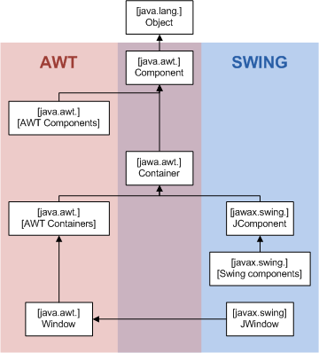
Technologies Used
Java Swing:
Java Swing tutorial is a part of Java Foundation Classes (JFC) that is used to create window-based applications.
It is built on the top of AWT (Abstract Windowing Toolkit) API and entirely written in java.
Unlike AWT, Java Swing provides platform-independent and lightweight components.
The javax.swing package provides classes for java swing API such as JButton, JTextField, JTextArea, JRadioButton, JCheckbox, JMenu, JColorChooser etc.

Slide 14
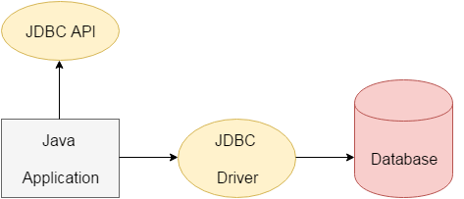
Technologies Used
JDBC:
Java Database Connectivity (JDBC) is an application programming interface (API) for the programming language Java, which defines how a client may access a database.
It is a Java-based data access technology used for Java database connectivity.
It is part of the Java Standard Edition platform, from Oracle Corporation

Slide 15
System Analysis
FEASIBILITY ANALYSIS:
Whatever we think need not be feasible. It is wise to think about the feasibility of any problem we undertake. Feasibility is the study of impact, which happens in the organization by the development of a system. The impact can be either positive or negative. When the positives nominate the negatives, then the system is considered feasible. Here the feasibility study can be performed in two ways such as technical feasibility and Economical Feasibility.
Technical Feasibility:
We can strongly say that it is technically feasible, since there will not be much difficulty in getting required resources for the development and maintaining the system as well.

Slide 16
System Analysis
All the resources needed for the development of the software as well as the maintenance of the same is available in the organization here we are utilizing the resources which are available already.
Economic Feasibility:
Development of this application is highly economically feasible. The organization needed not spend much m one for the development of the system already available. The only thing is to be done is making an environment for the development with an effective supervision. I f we are doing so, we can attain the maximum usability of the corresponding resources. Even after the development, the organization will not be in a condition to invest more in the organization. Therefore, the system is economically feasible.

Slide 17
System Design
It is a process of planning a new business system or replacing an existing system by defining its components or modules to satisfy the specific requirements.
Before planning, you need to understand the old system thoroughly and determine how computers can best be used in order to operate efficiently.
System Design focuses on how to accomplish the objective of the system.
SDLC MODEL
System Architecture
UML Diagrams.

Slide 18
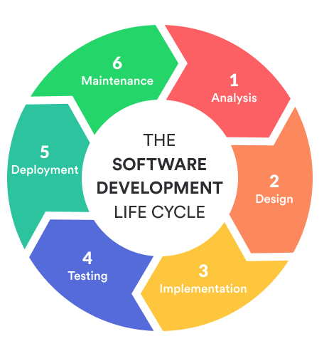
AGILE SDLC MODEL
Agile SDLC model is a combination of iterative and incremental process models with focus on process adaptability and customer satisfaction by rapid delivery of working software product.
Agile Methods break the product into small incremental builds. These builds are provided in iterations.
Each iteration typically lasts from about one to three weeks.

Slide 19
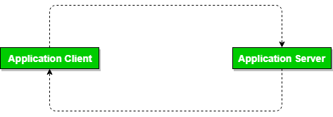
System Architecture
Two tier architecture is similar to a basic client-server model. The application at the client end directly communicates with the database at the server side.
API’s like ODBC,JDBC are used for this interaction. The server side is responsible for providing query processing and transaction management functionalities. On the client side, the user interfaces and application programs are run.
The application on the client side establishes a connection with the server side in order to communicate with the DBMS.
An advantage of this type is that maintenance and understanding is easier, compatible with existing systems. However this model gives poor performance when there are a large number of users.

Slide 20
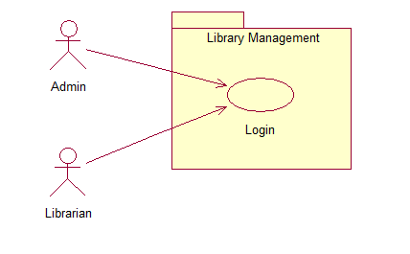
System Use Case Diagram

Slide 21
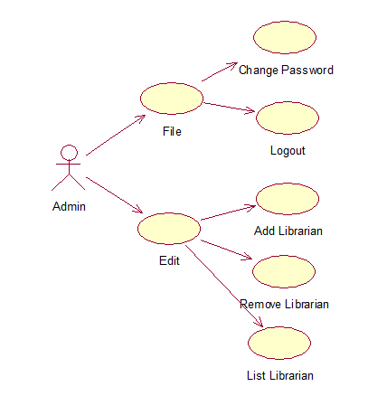
Admin Use Case Diagram

Slide 22
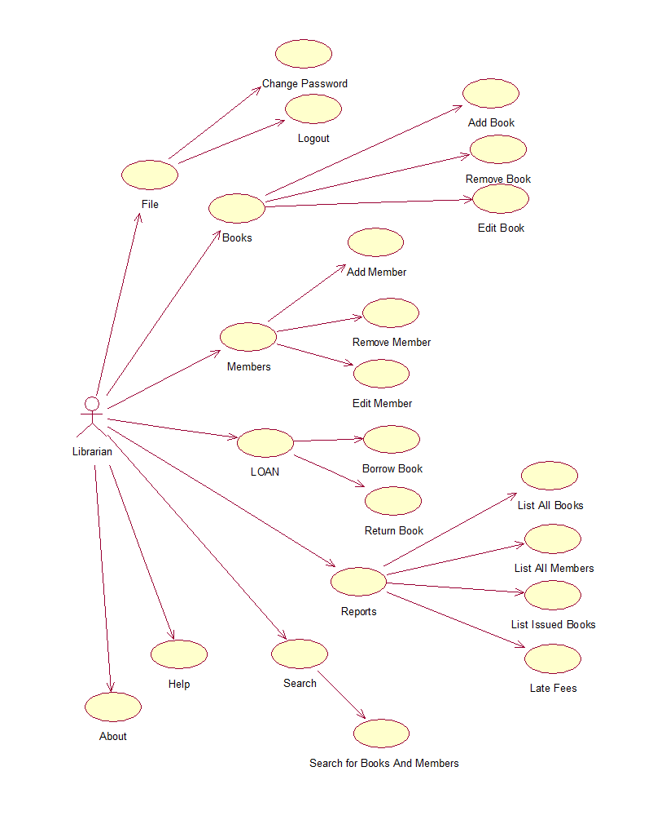
Librarian Use Case Diagram

Slide 23
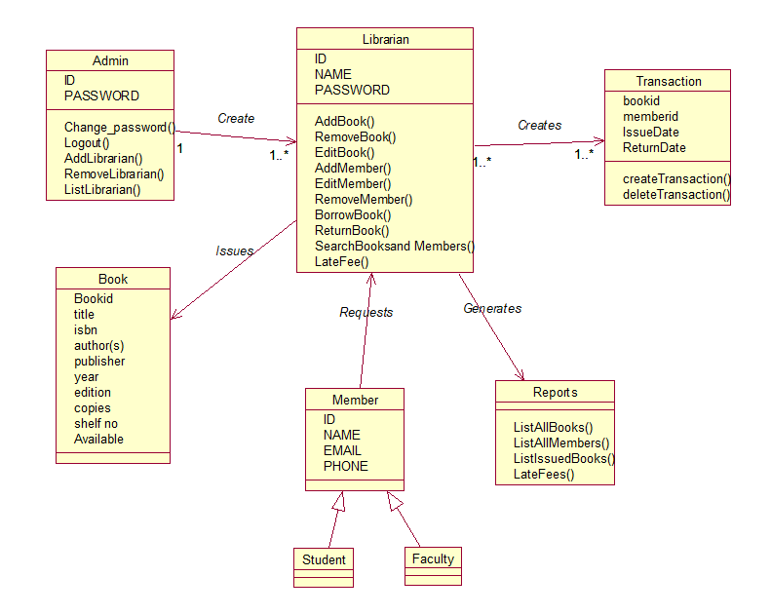
Class Diagram

Slide 24
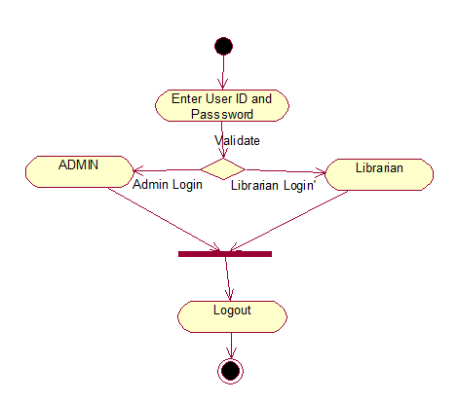
Login
Activity Diagram

Slide 25
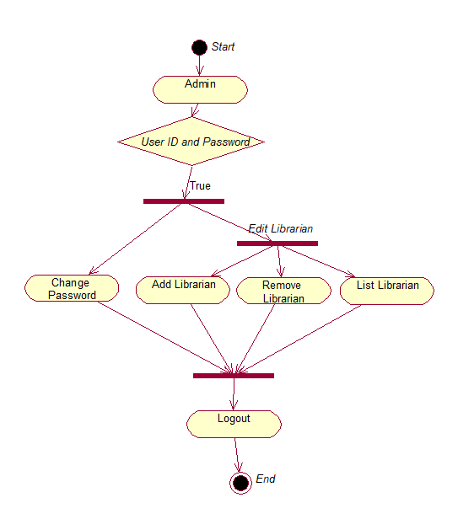
Admin
Activity Diagram

Slide 26
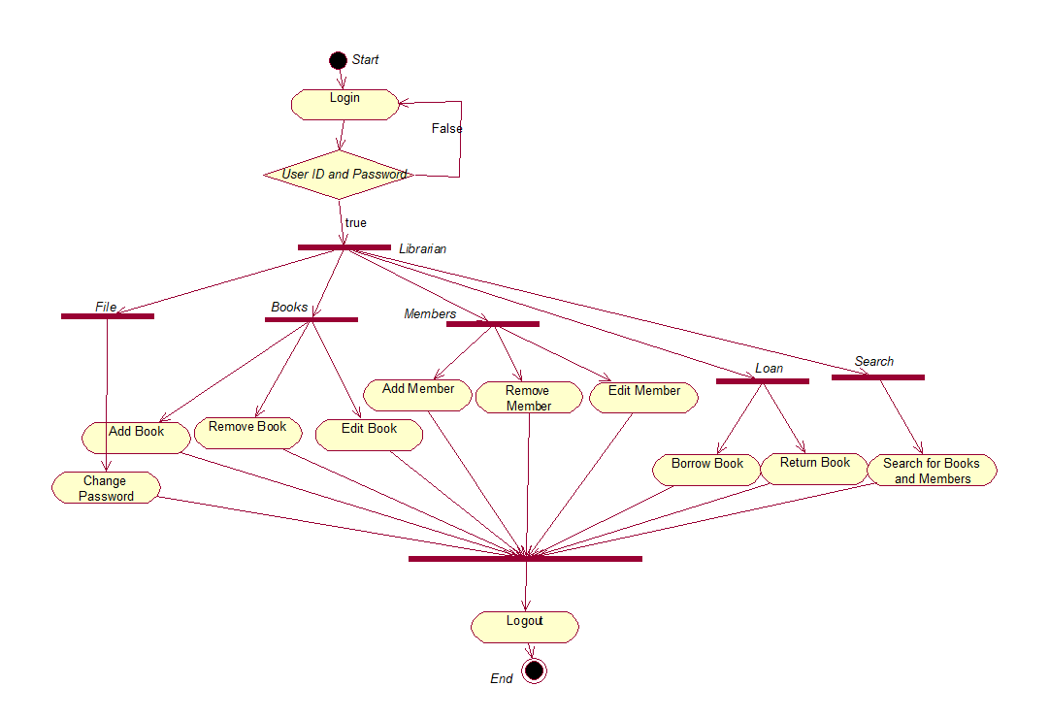
Librarian Activity Diagram

Slide 27
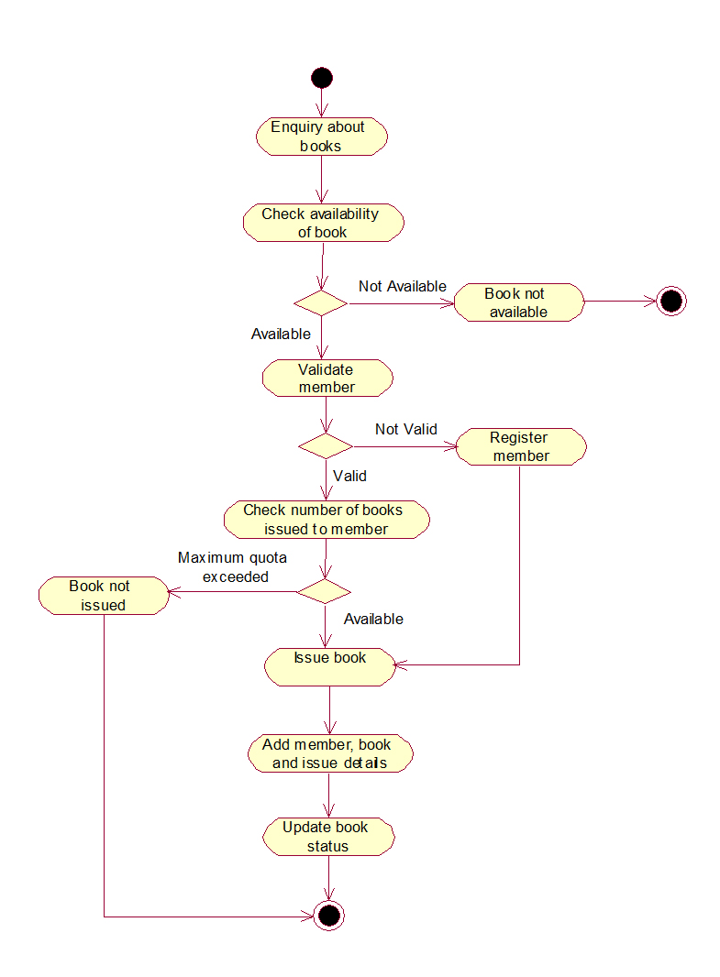
Activity Diagram

Slide 28
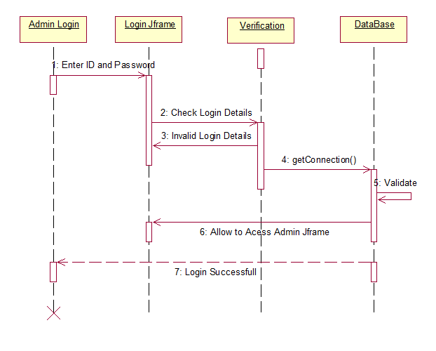
Admin Login Sequence Diagram

Slide 29
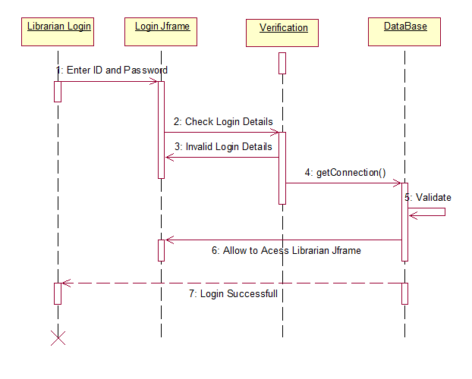
Librarian Login Sequence Diagram

Slide 30
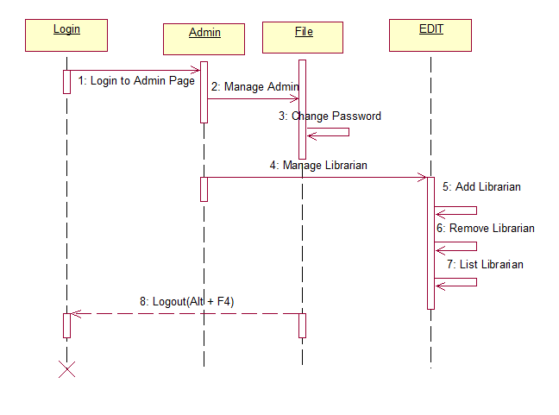
Admin Sequence Diagram

Slide 31
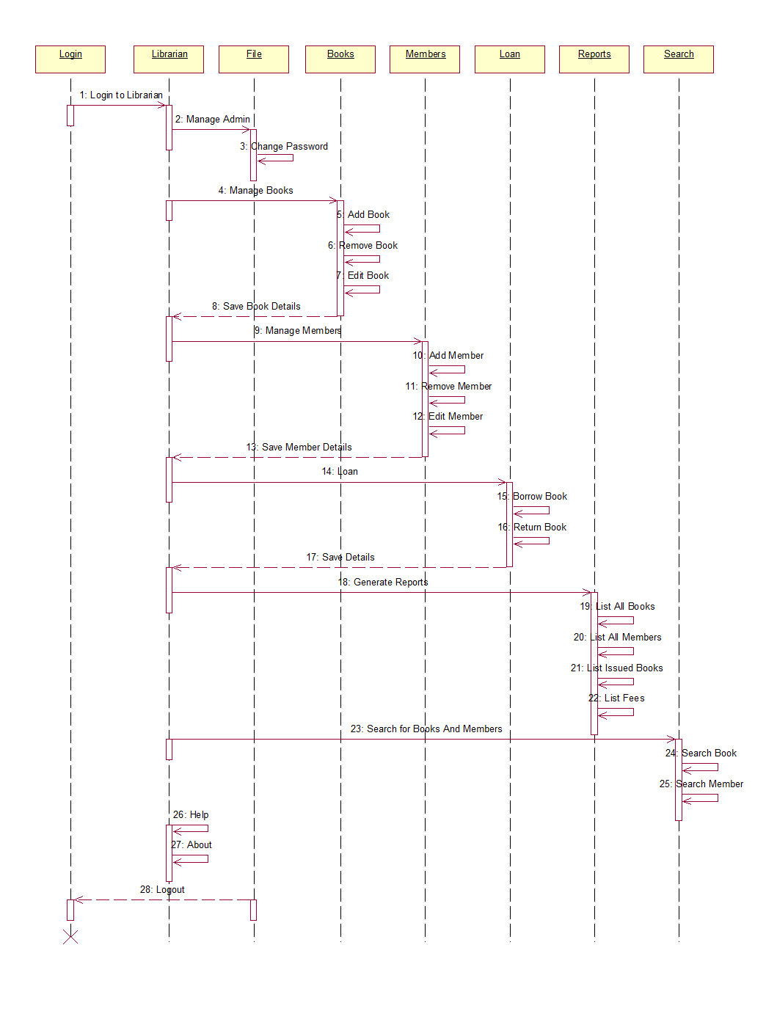
Librarian Sequence Diagram

Slide 32
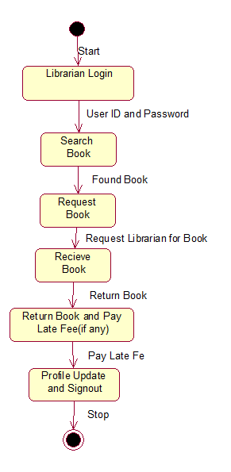
State Chart Diagram

Slide 33
Conclusion:
The Project LIBRARY MANAGEMENT is for computerizing the working in a library.
The Software takes care of all the requirements of an a library and is capable to provide easy and effective storage of information related to Books and Members.

Slide 34
Future Work:
In the near future, technology is growing rapidly and so this “Library Management” will be very helpful in the future.
Every College and local library can use this system.
Ease to Access and No loss of time.
In future, Members can read online books like [.pdf] from library just by logging there account.

Slide 35
References:
https://en.wikipedia.org
https://www.tutorialspoint.com/sdlc/sdlc_agile_model.htm
JDBC 4.2, Servlet 3.1, and JSP 2.3 Includes JSF 2.2 and Design Patterns, Black Book- Santosh Kumar
Java Complete Reference - Herbert Schildt.
https://www.javatpoint.com/java-tutorial

